Slide 1
Lesson -What is Light?
SWBAT-Explain how light travels

Slide 2
Science Starter
Create a Venn Diagram comparing and contrasting TWO DIFFERENT types of waves you are familiar with

Slide 3
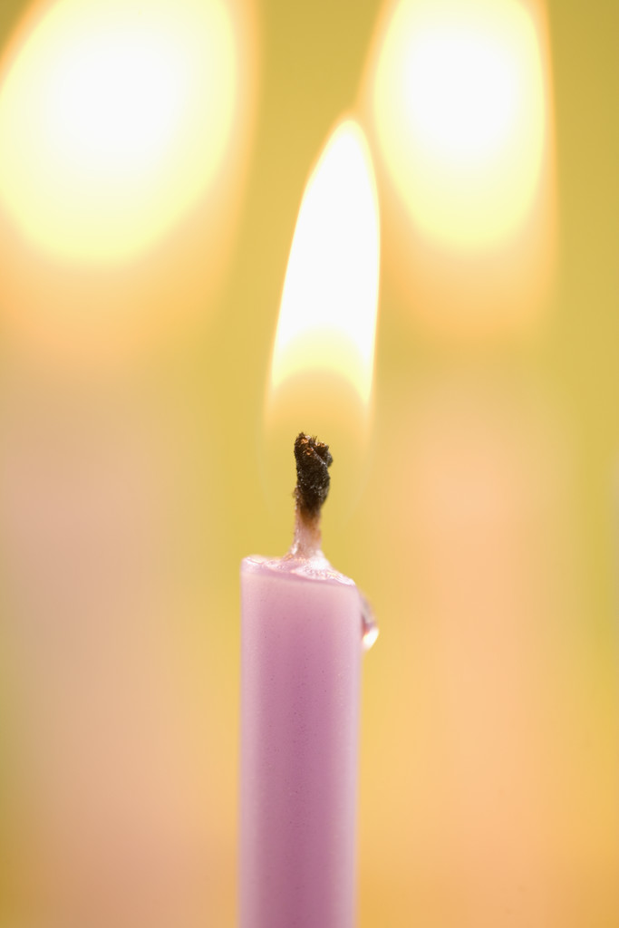
What is light?
Light-type of wave that carries energy
Light ray- narrow beam of light that travels in a straight line

Slide 4
Brainpop- “Light”
Take notes while we watch the video clip

Slide 5
How does light move/travel?
Medium-material through which a wave travels
Example-water wave travels through a medium of water
Light does not need a medium because it is an electromagnetic wave
Travels in all directions away from the light source

Slide 6
Light & Matter
Most objects do not give off light
To see an object light waves must hit the object-bounce off the object into your eyes
Reflection-light striking an object and bouncing off
light waves strike an object; waves can be-
absorbed by the object
reflected
pass through it
Depends on the material

Slide 7
Read lab: “Science Experiment Light Travels”
SWBAT-Explain how light travels
Activity Instructions

Slide 8
Exit Slip
Exit Slip: On the lab, Make a prediction explaining how YOU think light travels​

Slide 9
Lesson-what is light…continued!
SWBAT-Explain how light travels

Slide 10
opaque, transparent & translucent
Opaque
translucent
transparent
allows no light to pass through
Ex: table
Allows some light to pass through
Ex: wax paper
Allows nearly all light to pass through
Ex: glass

Slide 11
Color
The light from the Sun might look white, but it is a mixture of colors.
Each color has a different wavelength length
Red light=longest wavelengths
violet light =shortest wavelengths.

Slide 12
Color
White light is separated into different colors when it passes through a prism.
The colors in white light range from red to violet.
When light waves from all these colors enter the eye at the same time, the brain interprets the mixture as being white.

Slide 13
Why do objects have color?
If an object reflects red waves and absorbs all the other waves, it looks red.
An object that reflects all the light waves that strike it looks white, while one that reflects none of the light waves that strike it looks black.

Slide 14
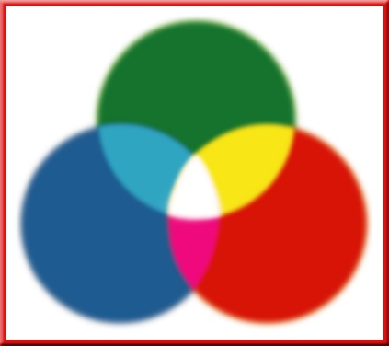
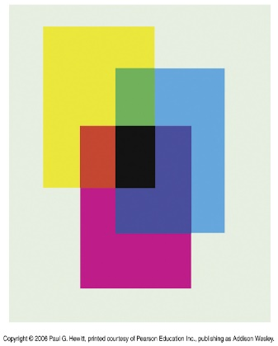
Colors
Primary LIGHT colors
Primary pigment colors
Red, green and blue are known as primary colors
Light of almost any color can be made by mixing different amounts of red, green and blue light
Yellow, magenta and cyan are the primary pigment colors
Primary Pigment colors result when a pigment absorbs a primary light color

Slide 15
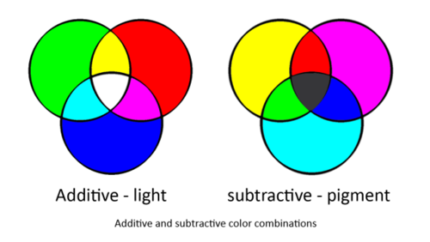
light colors vs. pigment colors

