Slide 1
Reflection & Mirrors
SWBAT-Explain how light is reflected from rough and smooth surfaces

Slide 2
Science Starter
Describe how light travels.

Slide 3
The Law of Reflection
Law of Reflection-When a light ray strikes a surface and is reflected
Normal-Imaginary line that is drawn perpendicular to the surface where the light ray strikes.

Slide 4
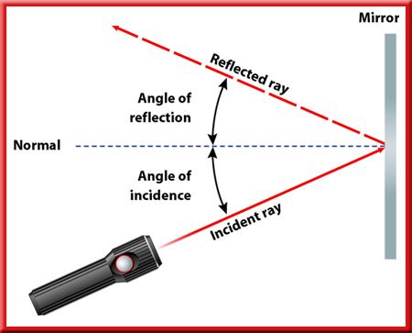
The Law of Reflection
The incident ray and the normal form an angle called the angle of incidence.
The reflected light ray forms an angle with the normal called the angle of reflection.

Slide 5
The Law of Reflection
law of reflection states that the angle of incidence is equal to the angle of reflection.

Slide 6
Reflection from Surfaces—
Regular VS Diffuse Reflection
Rough Surface Reflection
Smooth Surface Reflection
uneven reflection of light waves from a rough surface
Causes light waves to reflect in all directions
Even/parallel reflection of light waves from and even surface

Slide 7
Continue Here on Monday!

Slide 8
Concave VS Convex Mirrors
Convex Mirror
Concave Mirror
has a surface that curves outward, like the back of a spoon
Convex mirrors cause light waves to spread out, or diverge.
a surface that is curved inward, like the bowl of a spoon.
Unlike plane mirrors, concave mirrors cause light rays to come together, or converge

Slide 9
Scattering of Light
When diffuse reflection occurs, light waves that were traveling in a single direction are reflected, and then travel in many different directions.
This is known as scattering.
Scattering also can occur when light waves strike small particles, such as dust.

Slide 10
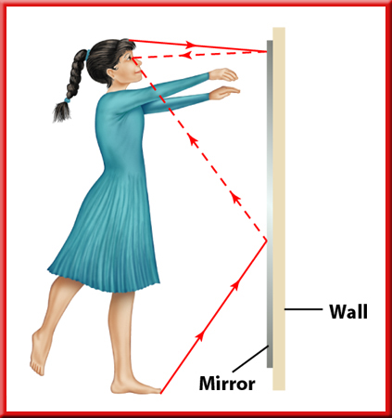
Reflection and Mirrors
2
Reflection by Plane Mirrors
Light waves from the Sun or another source of light strike each
part of the person.
These light rays bounce off the person according to the law of reflection, and some of them strike the mirror.

Slide 11
Reflection and Mirrors
2
Reflection by Plane Mirrors
The rays that strike the mirror also are reflected according to the law of reflection.

Slide 12
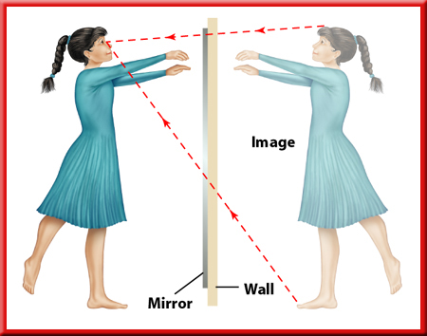
Reflection and Mirrors
2
The Image in a Plane Mirror
Although the light rays bounced off the mirror’s surface, your brain interprets them as having followed straight lines.
This makes the reflected light rays look as if they are coming from behind the mirror.

Slide 13
Reflection and Mirrors
2
Concave Mirrors
A straight line drawn perpendicular to the center of a concave or convex mirror is called the optical axis.
Light rays that travel parallel to the optical axis and strike the mirror are reflected so that they pass through a single point of the optical axis called the focal point.
The distance along the optical axis from the center of the mirror to the focal point is called the focal length.

Slide 14
Reflection and Mirrors
2
Concave Mirrors
If the object is farther from the mirror than the focal point, the image appears to be upside down, or inverted.
The size of the image decreases as the object is moved farther away from the mirror.
If the object is closer to the mirror than one focal length, the image is upright and gets smaller as the object moves closer to the mirror.

Slide 15
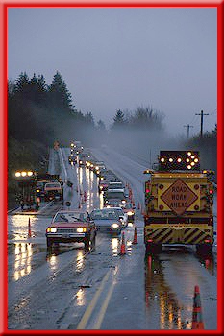
Reflection and Mirrors
2
Concave Mirrors
A concave mirror can produce a focused beam of light if a source of light is placed at the mirror’s focal point.
Flashlights and automobile headlights use concave mirrors to produce directed beams of light.

Slide 16
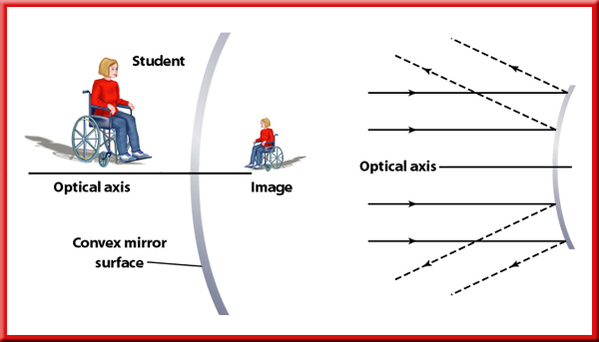
Reflection and Mirrors
2
Convex Mirrors
A convex mirror causes light rays to spread apart, or diverge.

Slide 17
Reflection and Mirrors
2
Convex Mirrors
Like the image formed by a plane mirror, the image formed by a convex mirror seems to be behind the mirror. The image always
is upright and smaller than the object.

Slide 18
Section Check
2
Question 1
According to the law of reflection, the _______ is equal to the _______.

Slide 19
Section Check
2
Answer
The law of reflection states that the angle of
incidence is equal to the angle of reflection.

