Slide 1
Lesson 2a-Sound Hearing: The Ear
Page: 54-55 in textbook

Slide 2
Facts About the Ear
The ear is a complex organ that is able to detect a wide range of sounds.
The ear can detect frequencies ranging from about 20Hz to about 20,000 Hz.
The ear also can detect a wide range of sound intensities.
The faintest sounds you can hear carry about one trillionth the amount of energy as the loudest sounds you can hear.

Slide 3
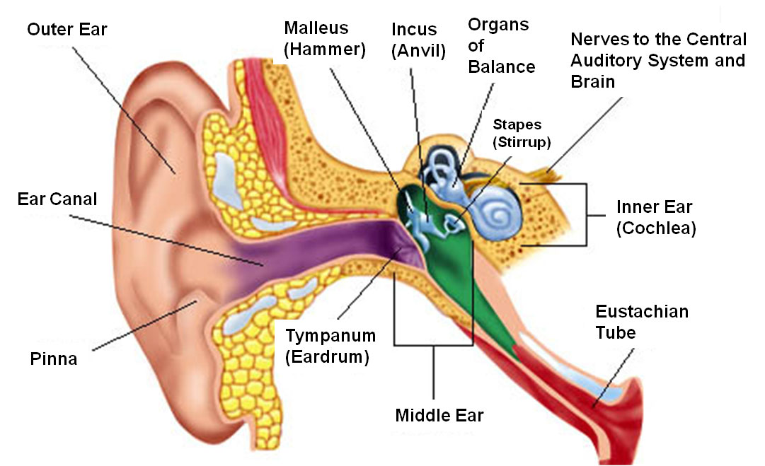
Parts of the Ear
The human ear has three parts—
Outer ear
Middle ear
3 bones
Malleus (hammer)
Incus (Anvil)
Stapes (Stirrups)
Inner ear.

Slide 4
The Outer Ear-Sound Collector
Job-to collect sounds and direct them to your ear canal
Animals rely on hearing just as much as humans

Slide 5
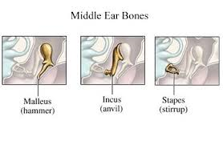
The Middle Ear-Sound Amplifier
Sound waves vibrate the eardrum
Eardrum-membrane that stretches across the ear canal like a drumhead
The vibrations move through 3 small connected bones-
Hammer- Malleus
Anvil-Incus
Stirrup-Stapes
Job of the bones-to amplify
the sound

Slide 6
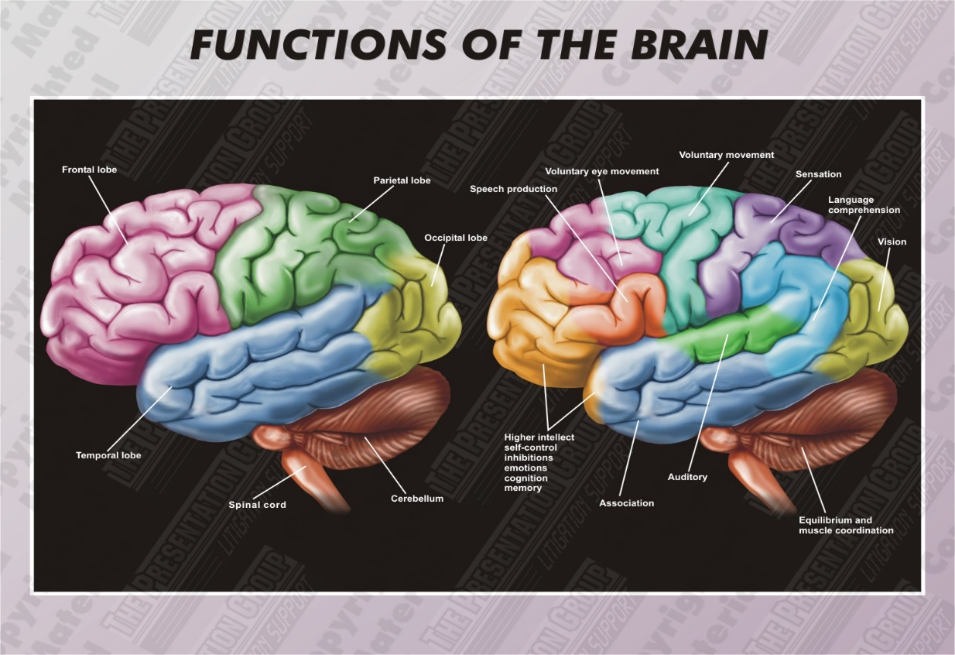
The Inner Ear- Sound Interpreter
Inner ear filled with fluid
The sound wave vibrations are moved through the fluid and hit little hair-tipped cells
The cells create signals about the frequency, intensity and length of sound
The nerve impulse travels along auditory nerve and is relayed to the portion of your brain that translates hearing

Slide 7
Part of Brain Responsible for Hearing

Slide 8
Hearing Loss
The ear can be damaged by disease, age, and exposure to loud sounds.
If damaged mammalian hair cells die, some loss of hearing results because mammals cannot make new hair cells.
It is estimated that about 30 percent of people over 65 have some hearing loss due to aging.

