Slide 1
Lesson 1a: What is Sound?
-Identify the characteristics of sound waves.
-Explain how sound travels.

Slide 2
Science Starter
What happens when a rock is tossed into a body of water such as a pond/lake?
When you are under water, can you hear sounds? What does this tell you about sound waves?

Slide 3
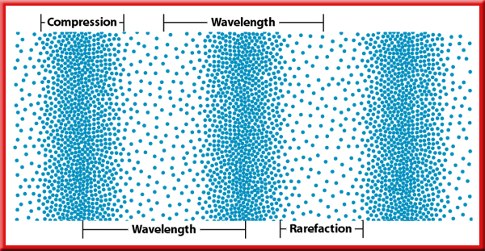
Sound & Vibration
Every noise is produced by vibrations
Sound waves are air molecules that move back and forth along the direction of the wave
Wave-carries energy from one place to another without transferring matter
Vocal chords vibrate-sound comes out of your mouth
Faster vibration= high frequency

Slide 4
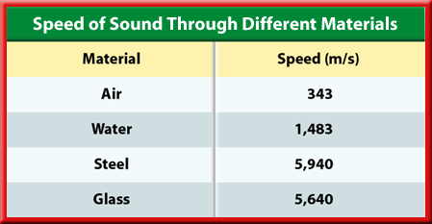
Speed of Sound
Temp affects sound travel
Sound waves can go through S, L, G and air
  hotter=the faster the sound wave moves
  Colder=the slower the sound wave moves
Sound waves travel faster in solids, slower in gases/liquids
The closer the molecules=the faster the wave moves

Slide 5
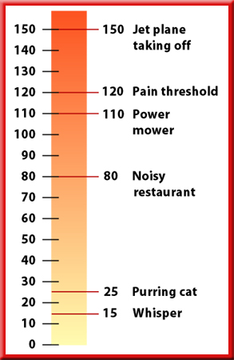
Amplitude & Loudness
Loud sound waves carry more energy
The higher the amplitude=more energy=LOUDER sound
Humans can hear between 3,000-4,000hz
Decibels are a measure of sound
Loudness-human perception of how much energy a sound wave carriers
Hearing damage occurs at 85 decibels

Slide 6
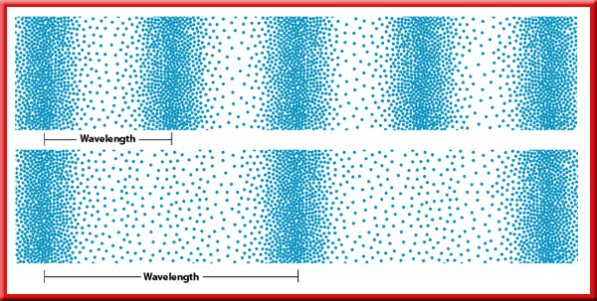
Frequency & Pitch
Pitch-the pitch of a sound is how high or low it sounds
Pitch corresponds to frequency of the sound
If a wavelength is shorter=there are more compressions/rarefactions

Slide 7
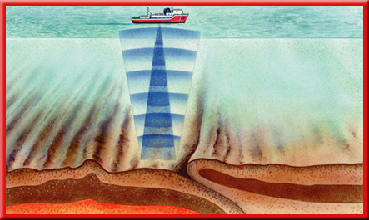
Echoes
Echo-reflective sound wave
Echolocation- is a method some animals use to hunt and travel
  Ex: bats, dolphins
The amount it takes an echo to come back to you depends on how far away the reflective surface is
Can be used to detect submarines, fish, and other objects

Slide 8
Doppler Effect
Doppler Effect- change in frequency that occurs when a source of sound is moving to a listener
Occurs whether or not the listener is listening
Amount of diffraction depends on wavelength of sound waves compared to the size of an obstacle/opening
The noise gets louder as it gets closer to the man. It is the loudest when it passes the man. As it moves away from the man the noise gets softer.

Slide 9
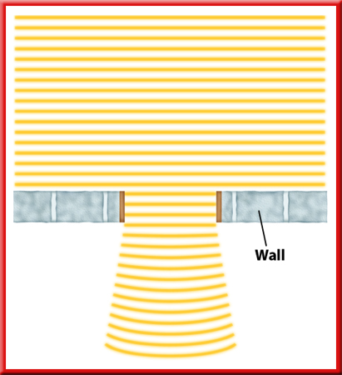
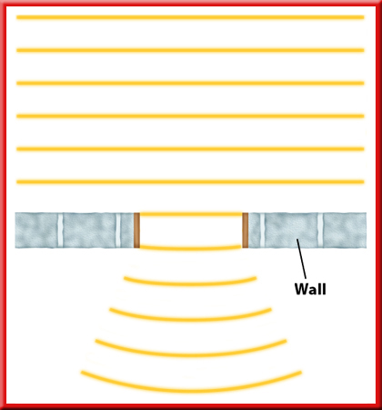
Diffractions of Sound Waves
Diffraction- happens when a wave bends around an obstacle
Allows us to hear someone around a corner
Amount of diffraction depends on the wavelength of the sound wave
Occurs when a wave spreads out after passing through an opening
Picture on page 44
If the wavelength is much smaller than the obstacle, almost no diffraction occurs.
As the wavelength becomes closer to the size of the obstacle, the amount of diffraction increases.

Slide 10
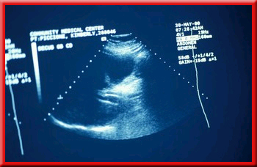
Using Sound Waves
Can be used for medical purposes
Sound waves can be used in ultrasounds
Ultrasounds-take pictures of organs inside your body (pic page 45)
  Use high frequency sound waves in medical procedures

