Slide 1
Wave Properties
Lesson 2-Waves
Describe the relationship between the frequency and wavelength.

Slide 2
Science starter
Compare and contrast a transverse wave and a compressional wave.
How are they similar and how are they different?

Slide 3
Review from last week… How are waves, energy and matter related? Waves, energy and matter are related because all waves carry energy and some transfer energy through matter.
What is a wave?
Rhythmic disturbances that carry energy without carrying matter are called waves.
What is energy?
"Energy is defined as the ability to do work.” http://www.kids.esdb.bg/example_principles.html
What is matter?
“Matter is everything around you. Matter is anything made of Atoms and molecules. Matter is anything that has mass and takes up space.” http://www.chem4kids.com/files/matter_intro.html

Slide 4
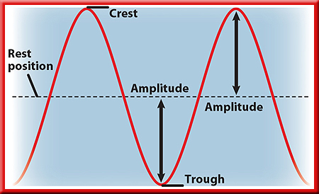
Amplitude
Amplitude-how high a wave rises above, or falls below, the normal level.
Draw this!
Amplitude of a transverse wave is one-half the distance between a crest and a trough.

Slide 5
Amplitude and Energy
A wave’s amplitude is related to the energy that the wave carries.
For example, the electromagnetic waves that make up bright light have greater amplitudes than the waves that make up dim light.

Slide 6
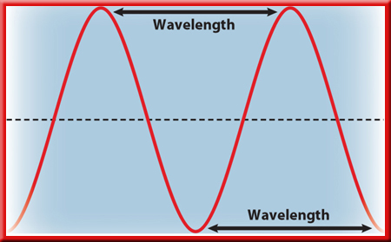
Wavelength for a Transverse Wave
the distance from the top of one crest to the top of the next crest, or from the bottom of one trough to the bottom of the next trough.
Draw this!

Slide 7
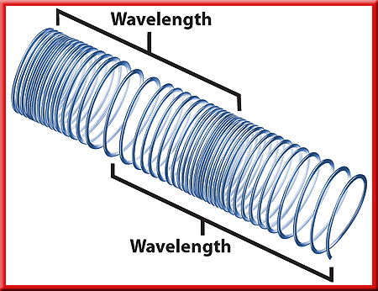
Wavelength for a Compressional Wave
the wavelength is the distance between the center of one compression and the center of the next compression
Draw this!

Slide 8
Frequency
Frequency- the number of wavelengths that pass a given point in 1 s.
Unit of frequency is the number of wavelengths per second, or hertz (Hz).
The faster the vibration is, the higher the frequency is of the wave that is produced.

Slide 9
Frequency and Wavelength
Smaller frequencies=longer wavelengths.
Higher frequencies=shorter wavelengths.
This is true for all waves that travel at the same speed. As the frequency of a wave increases, its wavelength decreases.

Slide 10
Wave Speed
F.Y.I!
When mechanical waves, such as sound, and electromagnetic waves, such as light, travel in different materials, they change speed.
Light travels through air at about 300 million m/s.
Sound travels through air at about 340 m/s.
Mechanical waves
Electromagnetic waves
Tend to travel faster in solids and slower in gases
Tend to travel faster in gases and slower in solids

Slide 12
Wave Behaviors
Lesson 2-Waves
Explain 3 behaviors of waves.
-reflection
-refraction
-diffraction

Slide 13
Science Starter
1. Describe the relationship between frequency and wavelength.

Slide 14
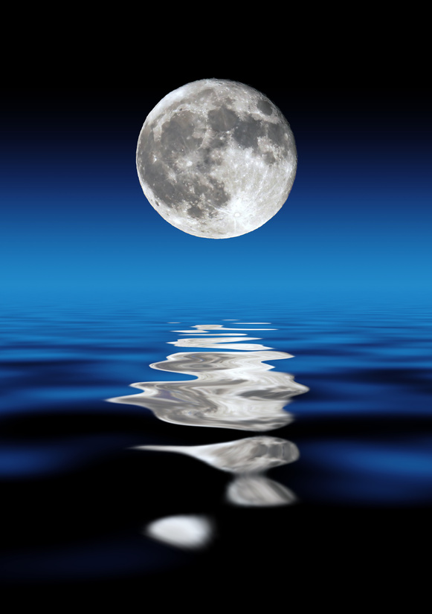
Reflection
Reflection occurs when a wave strikes an object or surface and bounces off.
Sound reflects from all surfaces.
Your echo bounces off the walls, floor, ceiling, furniture, and people.

Slide 15
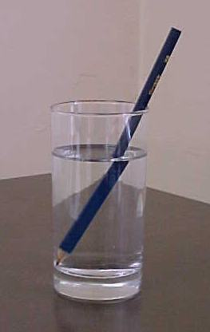
Draw this!
Refraction
The bending of a wave as it moves from one medium into another is called refraction.

Slide 16
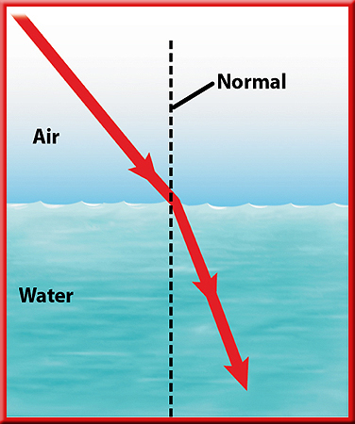
Refraction and Wave Speed
Happens when the speed of a wave changes as it passes from one substance to another.
Draw this!
A line that is perpendicular to the water’s surface is called the normal.
When a light ray passes from air into water, it slows down and bends toward the normal.

Slide 17
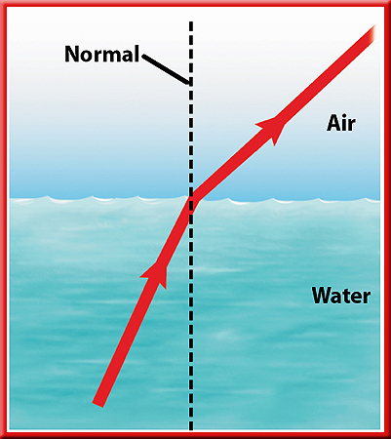
Refraction and Wave Speed
When the ray passes from water into air, it speeds up and bends away from the normal.

Slide 18
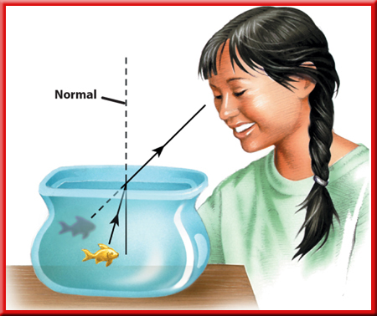
Example of Refraction and Wave Speed
Refraction makes the fish appear to be closer to the surface and farther away from you than in really is.

Slide 19
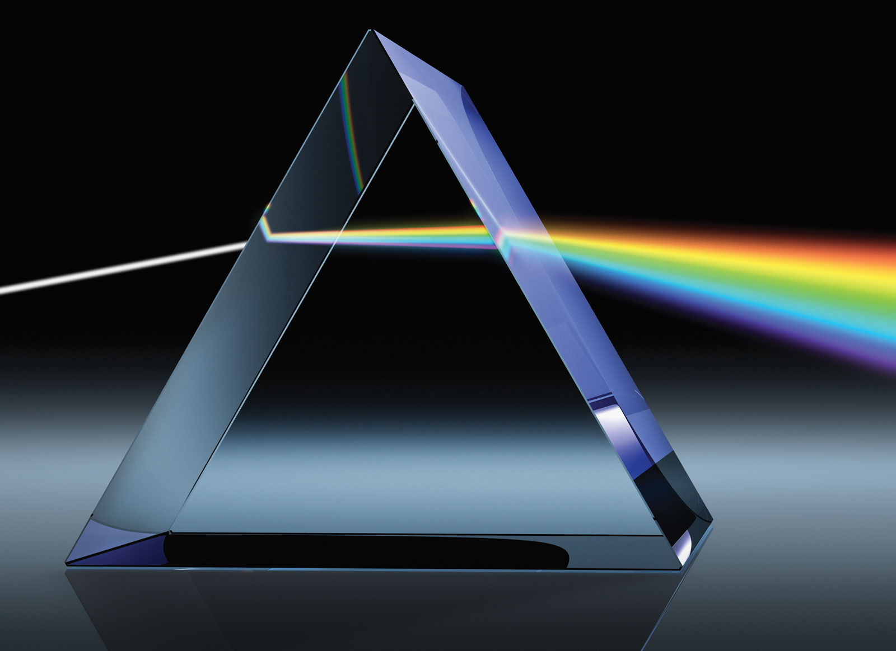
Color from Refraction
When sunlight passes through a prism, refraction occurs twice: once when sunlight enters the prism, and again when it leaves the prism and returns to the air.
Violet light has the shortest wavelength and is bent the most.
Red light has the longest wavelength and is bent the least.

Slide 20
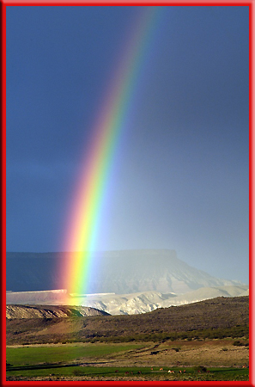
Color from Refraction
Colors in a rainbow are in order of decreasing wavelength:
Red(largest wavelength)
Orange
Yellow
Green
Blue
Indigo
Violet (smallest wavelength)
Refraction produces a rainbow when light waves from the Sun pass into and out of water droplets.

Slide 21
Diffraction
Why can you hear music from the band room when you are down the hall?
Sound waves bend as they pass through an open doorway.
Diffraction is the bending of waves around a barrier.
Light waves do bend around the edges of an open door.
However, for an opening as wide as a door, the amount the light bends is extremely small.

Slide 22
Wave Interference
While two waves overlap a new wave is formed by adding the two waves together.
Interference-two waves combine to form a new wave

