Slide 1

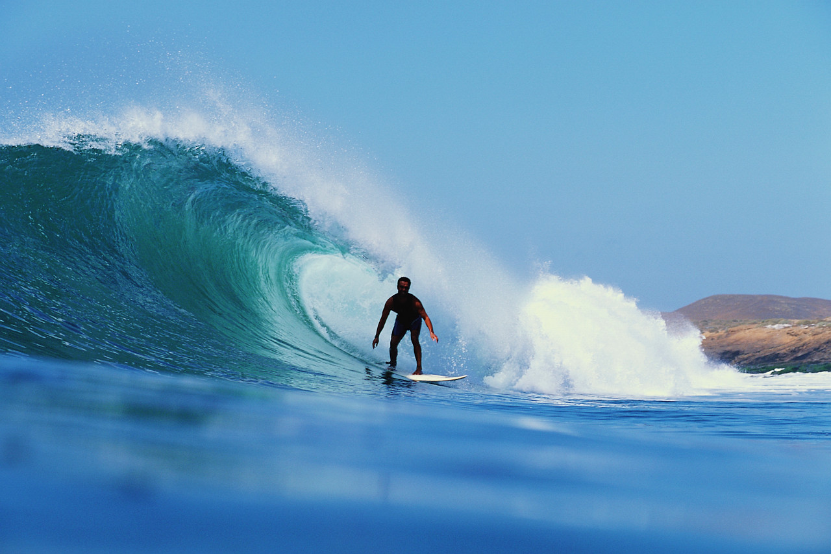
SWBAT: Explain the relationship among waves, energy and matter
Chapter 1: Waves
Section 1: What are Waves

Slide 2
Science Starter
1. Name 3-5 types of waves.
2. What do you think creates waves on the ocean?

Slide 3
What does a wave look and feel like?
When you are relaxing on an air mattress in a pool and someone does a cannonball dive off the diving board, you suddenly find yourself bobbing up and down.
The up-and-down motion was caused by the peaks and valleys of the ripple that moved from where the splash occurred.
These peaks and valleys make up water waves.

Slide 4
What are waves?
Rhythmic disturbances that carry energy without carrying matter are called waves.
You can see the energy of the wave from a speedboat traveling outward, but the water only moves up and down.

Slide 5
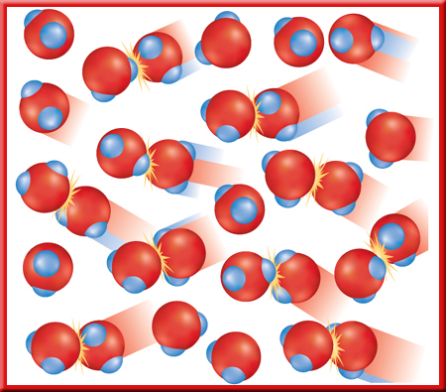
A Model for Waves
Think about the ripples on the surface of a pond. The energy carried by the ripples travels through the water.
In a water wave, water molecules bump each other and pass energy from molecule to molecule.
All waves transfer energy.

Slide 6
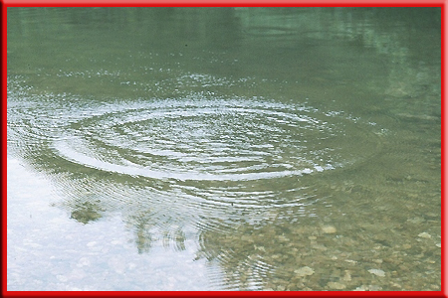
Type of Wave- Mechanical Waves
Draw this!
Waves, which use matter to transfer energy, are called mechanical waves.
A mechanical wave travels as energy is transferred from particle to particle in the medium.
The matter through which a mechanical wave travels is called a medium.
Example: a sound wave is a mechanical wave it can travel through air, solids, liquids, and other gases.
For ripples on a pond, the medium is the water.

Slide 7
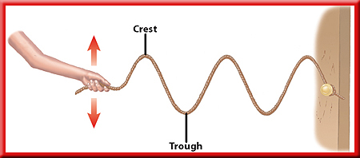
Type of wave- Transverse Waves
In a mechanical transverse wave, the wave energy causes the matter in the medium to move up and down or back and forth at right angles to the direction the wave travels.
The high points on the waves are called crests and the low points are called troughs.
Draw this!
Try this…
Stretch a long rope out on the ground. hold one end in your hand. Now shake the end in you hand back and forth.

Slide 8
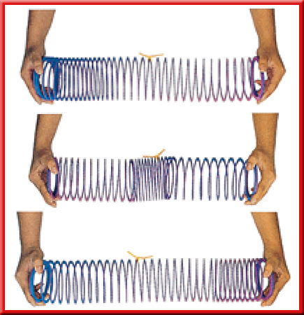
Type of Wave- Compressional Wave
Mechanical waves can be either transverse or compressional.
Compressional (longitudinal) wave-matter in the medium moves forward and backward along the same direction that the wave travels.
Draw this!
Try this…
You can make a compressional wave by squeezing together and releasing several coils of a coiled spring toy.

Slide 9

Example of Compressional Wave= Sound Waves
Sound waves are compressional waves.
If you touch a stereo speaker while it’s playing, you can feel it vibrating.
All waves are produced by something that is vibrating.

Slide 10
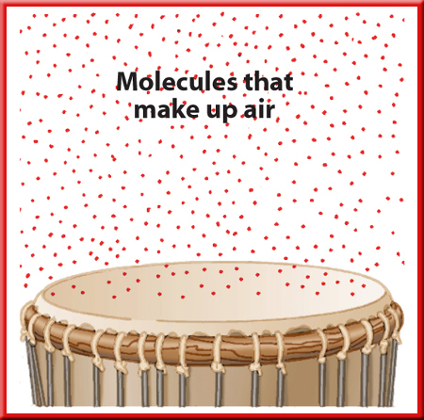
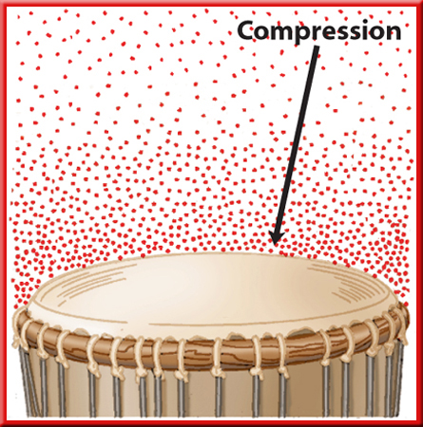
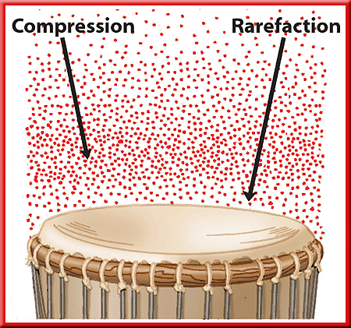
Making Sound Waves
When the drumhead moves downward, the molecules near it have more room and can spread farther apart.
When you hit the drumhead it starts vibrating up and down.
As the drumhead moves upward, the molecules next to it are pushed closer together.
As the drumhead vibrates up and down, it forms a series of compressions and rarefactions that move away and spread out in all directions.
Series of compressions and rarefactions is a sound wave.
Group of molecules that are closer together is a compression.
Group of molecules that are farther apart is a rarefaction.

Slide 11
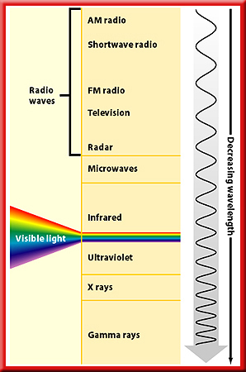
Electromagnetic Waves
Draw this!
electromagnetic waves- waves that can travel through space where there is no matter are
Can travel in matter or in space.
Examples of electromagnetic waves are:
  radio waves
  infrared waves
  visible light waves
  ultraviolet waves
  x rays
  gamma rays.

Slide 12
Exit Slip- What is the relationship among waves, energy and matter?
Get started on your homework…
Make vocabulary cards for new vocab words…
- Waves
-Mechanical waves
-Transverse waves
-Crests
-Trough
-Compressional wave
-Compression
-Rarefaction
-Sound wave
-Electromagnetic waves

